Slide 1
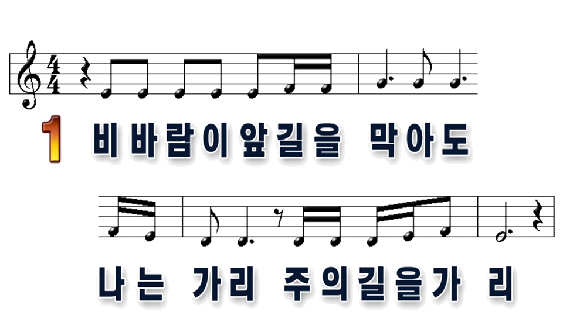

1
2

Slide 2
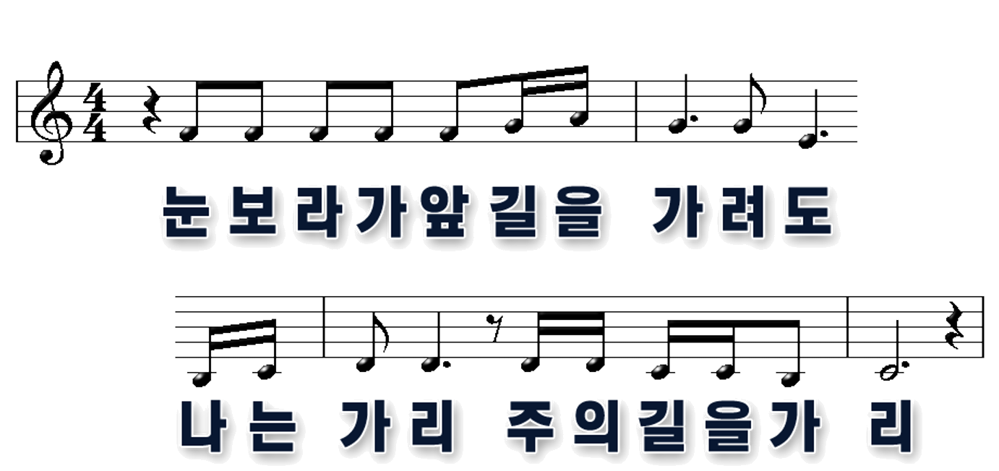
1
2

Slide 3
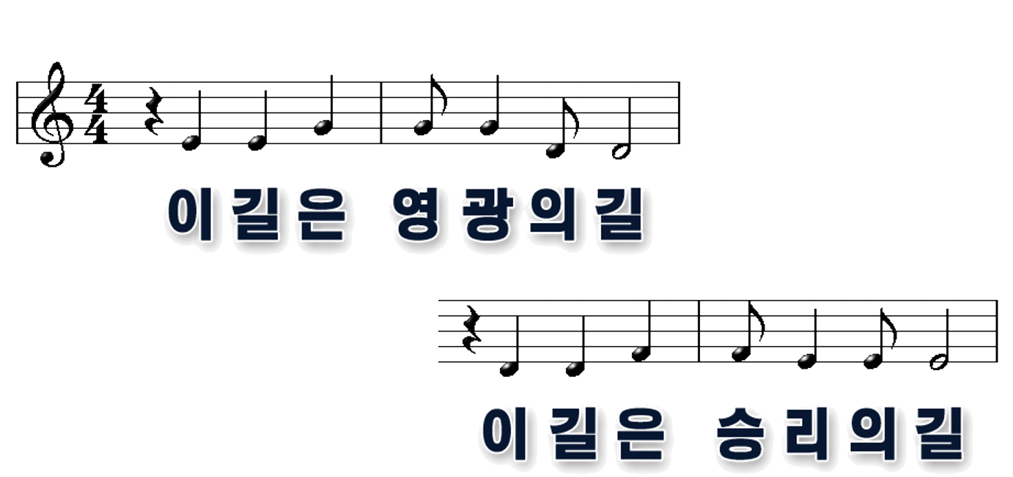
1
2

Slide 4
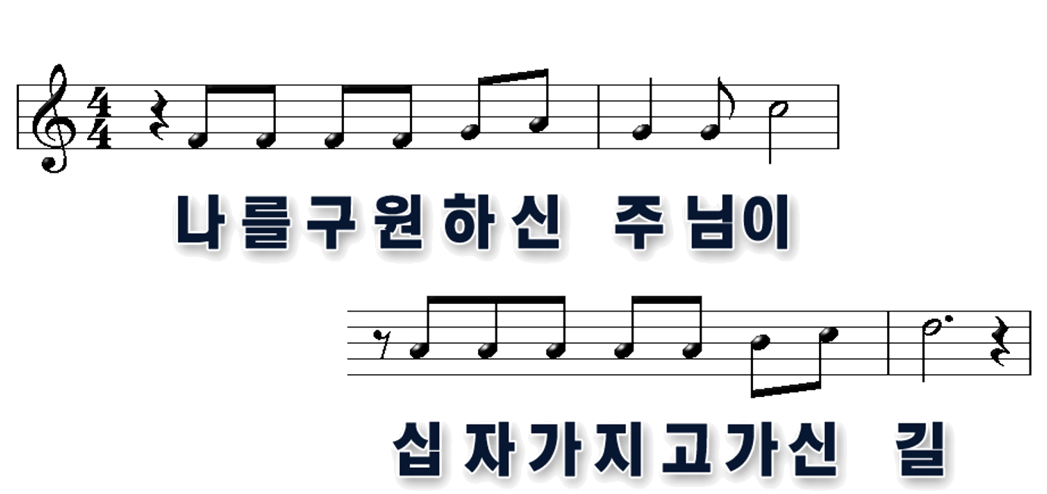
1
2

Slide 5
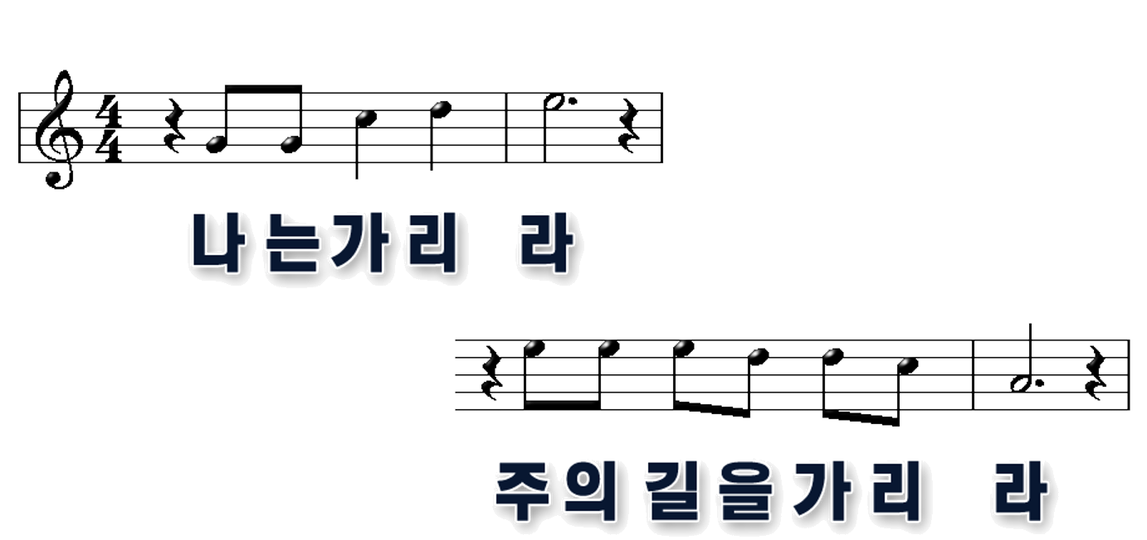
1
2

Slide 6
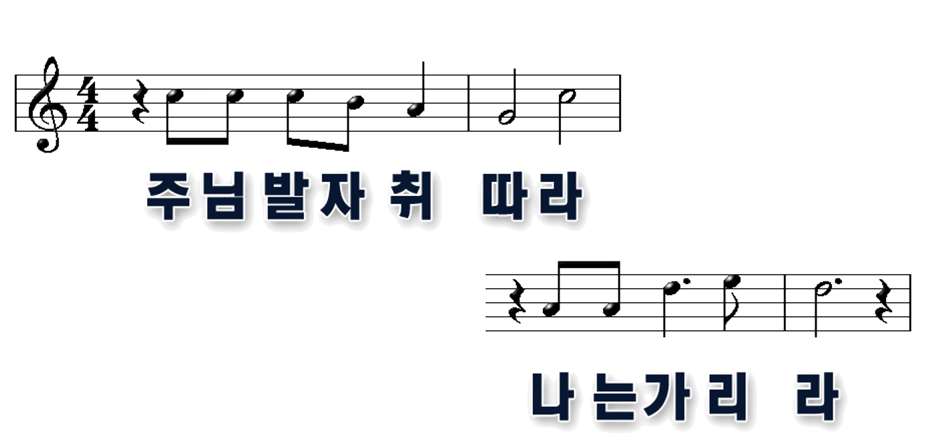
1
2

Slide 7
1
2

Slide 8
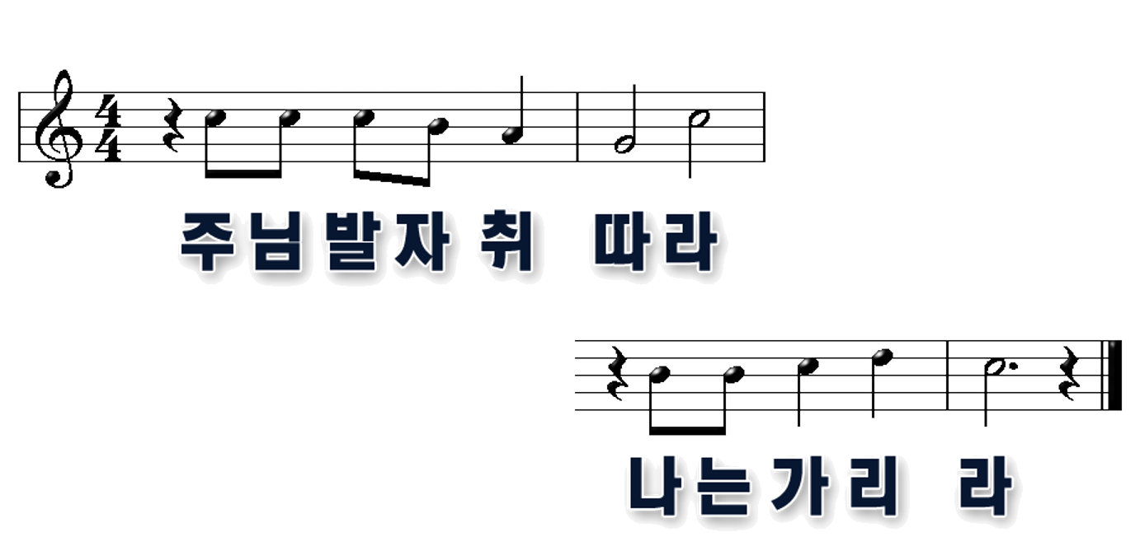
1
2

Slide 9
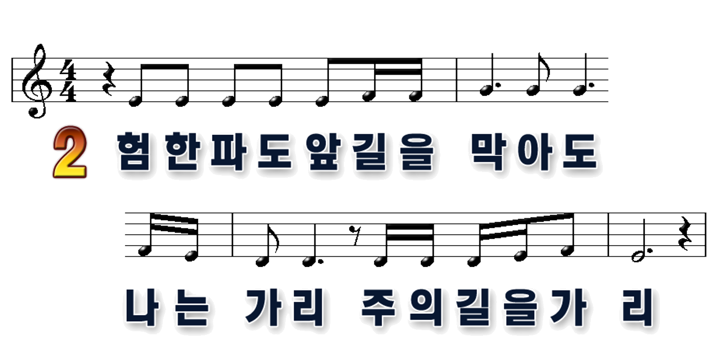
1
2

Slide 10
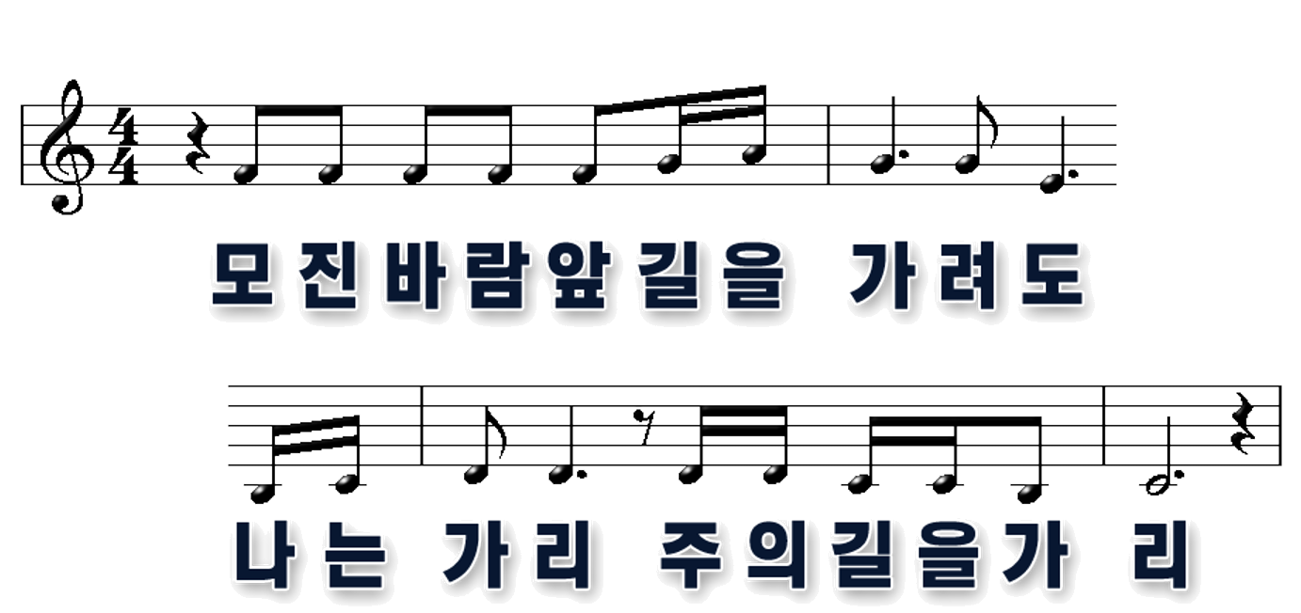
1
2

Slide 11
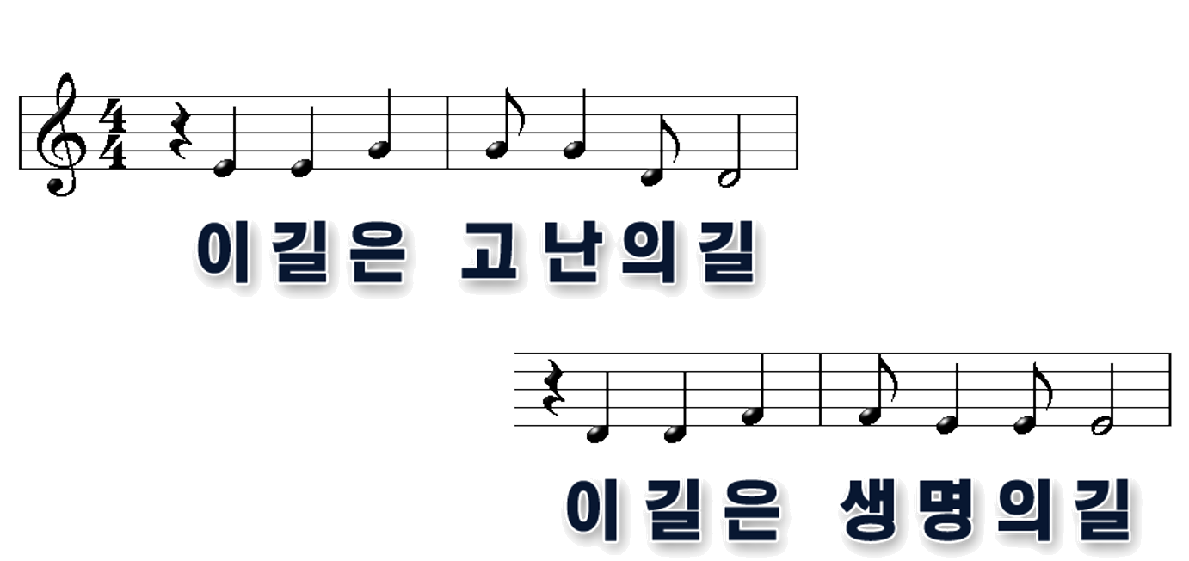
1
2

Slide 12
1
2

Slide 13
1
2

Slide 14
1
2

Slide 15
1
2

Slide 16
1
2

